Slide 1


Artificial Intelligence Scheduling: History & Uncertainty
PM2O/FRO, Tours, Nov 13-14, 2003
J. Christopher Beck
Cork Constraint Computation Centre
c.beck@4c.ucc.ie
Thanks to Thierry Vidal & Patrick Prosser

Slide 2
Outline: A Talk in Two Parts
AI Scheduling Systems
  Another look at “knowledge-based” scheduling
  Example system: DAS
Dealing with Uncertainty
  Reactive, Proactive, & Progressive approaches
  Examples

Slide 3
AI Scheduling Systems
Systems vs. Algorithms
Why Knowledge-based Scheduling?
Example: DAS

Slide 4
Thesis
There are differences between a “systems” approach and an “algorithmic” approach
The algorithmic approach is very popular now
It is useful revisit the systems approach

Slide 5
Algorithmic Approach
Start with real-world, messy, complicated scheduling problem
  Identify interesting component
    JSP, parallel machines, …
  Characterize component mathematically
  Develop algorithms to attack component
Common scientific approach

Slide 6
Algorithmic Approach
Strong results
  Edge-finding, resource envelopes, …
But is the original problem solved?
  Does a job shop exist?
  Can the algorithm actually be used in practice?
  Is the algorithm the hard/main part of solving the problem?

Slide 7
Systems Approach
Start with real-world, messy, complicated scheduling problem
  Develop system to solve it satisfactorily
Represent detailed problem & scheduling knowledge
Use knowledge to guide the search
  i.e., control the combinatorial explosion

Slide 8
Systems Approach
Ad hoc
  Especially when compared with algorithmic approach
Requires information/knowledge engineering & integration with the real world
  Database access
  Links with shop-floor system
Is this really scheduling research?
  Is it science?

Slide 9
Why Knowledge-based?
From M.S. Fox, “ISIS: A Retrospective”, 1994
“… the [human] scheduler was spending 10%-20% of the time scheduling and 80%-90% of the time communicating with other employees to determine what additional ‘constraints’ could affect an order’s schedule.”

Slide 10
Why Knowledge-based?
From M.S. Fox, “ISIS: A Retrospective”, 1994
“These constraints included operation precedence, operation alternatives, operation preferences, machine alternatives and preferences, tool availability, fixture availability, NC program availability, order sequencing, set up time reduction, machine breakdowns, machine capabilities, work-in-process time, due dates, start dates, shop stability, cost, quality, and personnel capabilities/availability.”

Slide 11
Why Knowledge-based?
80%-90% of the time the human scheduler was gathering information/knowledge
Conclusions:
  Algorithmic scheduling is not the main part of the problem
  Scheduling is the representation, gathering, and (then) reasoning, about this information

Slide 12
Example: DAS
Distributed Asynchronous Scheduler
  P. Prosser, P. Burke, U. of Strathclyde
  Developed in late ‘80s
Goal: develop and maintain a satisfactory schedule in an open world in near real-time
Deployed Alcan Plate Ltd.
  aluminum plate finishing

Slide 13
An Open World
Reactive
  What, When, Where can all change
  New orders, cancelled orders, machine breakdown, uncertain duration
  No difference between external change & internal change
Distributed
  Geographic, organizational, & logical
  Requires communication and coordination for problem solving

Slide 14
Representation: Operations
Detailed frame-based representation
Next/prev operation
Due date
Conflict history
Duration
Estimated end time
Type
Plan
Possible resources
Not during constraints
Operation type
Process
Resource
Select value
Start time
Possible start times
Priority

Slide 15
Architecture
S-agent
T-agent
T-agent
…
O-agent
O-agent
O-agent
O-agent
O-agent

Slide 16
Strategic level: S-agent
S-agent
{
}
S-agent
T-agent
T-agent
T-agent
Conflict resolution
conflict sets
inter-agent backtracking
due date relaxation
Delegation
operation priority
decision making seq.

Slide 17
Tactical Level: T-agent
T-agent
T-agent
{
}
O-agent
O-agent
O-agent
Delegation
filter based on aggregate view
domain specific strategy
Conflict resolution
retraction
ATMS

Slide 18
Operational level: O-agent
T-agent
T-agent
{
}
O-agent
O-agent
Scheduling
forward-checking
dependency-directed backtracking
shallow learning
domain dependent heuristics
Retraction
identify conflict set

Slide 19
Algorithmic Work
Forward checking
Customized ATMS
Dependency-directed backtracking
Shallow learning

Slide 20
Systems Work
Communication among agents
  Protocol & engineering
Shop-floor & user interfaces
Frame-based representation of evolving system
Incorporation of dynamic events
Domain-specific search heuristics
  Allocation & scheduling
Aggregate resource views

Slide 21
My Point
Real world optimization requires an information system within an organization
Research area: information engineering
  How to develop, organize, present, maintain, and reason about information to aid decision making
    Knowledge representation, human-computer interaction, organizational behaviour, optimization, databases, reasoning with uncertainty, …

Slide 22
Uncertainty in AI Scheduling
Reactive, Proactive, Progressive
Examples

Slide 23
Reactive Rescheduling
plan/schedule executed
react
new plan/schedule
Unexpected event
time
Not much memory needed to store the schedule
  but the search process might need space…

Slide 24
Reactive Rescheduling
One schedule to be executed
During execution something goes wrong
  e.g. a machine breaks down
Fix the schedule
  so execution can continue
  while minimizing some optimization criteria
    reaction time
    original (off-line) criteria
    perturbation
Notes:
This model is distinguished from pure dispatching by the fact that here an off-line schedule exists and some event occurs to make it inconsistent. In pure dispatching, no off-line schedule is created: the sequence in which activities are executed is determined entirely at execution time.

Slide 25
OPIS
Smith, “OPIS: A methodology and architecture for reactive scheduling”, 1994
Full scheduling system based on repeatedly reacting to events
Can be used for solving static problem
Blackboard architecture

Slide 26
OPIS: Execution Cycle
Pop
Analyze
Activate
Specialized KS
Conflict Queue
Resolve Conflict
External Event
Notes:
An event creates one or more conflicts which are prioritized in the conflict queue.
The highest priority conflict is popped and analyzed.
Based on both the conflict and the structure of the current schedule, a specialized knowledge source (KS) is activated to resolve the conflict.
The resolution process may produce subsequent conflicts.

Slide 27
OPIS: Conflict Analysis
A number of metrics are used to characterize the conflict
  resource idle time
  upstream/downstream slack
  projected lateness
The characterization of a conflict is used to select a KS

Slide 28
OPIS: Knowledge Sources
Each KS has a qualitative description of the conflict characteristics to which it can be usefully applied
A number of specialized KSs
  OSC - order-based scheduling
  RSC - resource-based scheduling
  RSH - right shifter
  DSW - demand swapper
Notes:
OSC – unschedules the activities associated with a job (from a certain time onward) and then reschedules them.
RSC – unschedules all activities on a resource (from a certain time onward) and then reschedules them. Actually does retraction/rescheduling iteratively stopping when a consistent solution is found. This tends to preserve as much of the existing schedule as possible.
DSW – exchange scheduled time and resource between similar processes.

Slide 29
OPIS: Comments
Sophisticated heuristic mechanisms for analysis of conflicts
Strong performance in real applications but no real detailed experimental analysis against other approaches
Tends to be a characteristic
of a systems approach:
a lot of effort to run comparisons

Slide 30
Proactive Scheduling
We know that something may go wrong
Create the schedule to reduce impact of events
Three main approaches
  Maximal coverage
  Flexible
  Conditional
Notes:
This model does not pay any attention to what will happen at execution time to handle unexpected events. It is purely off-line.

Slide 31
Maximal Coverage
Assess the level of feasibility of the schedule knowing the uncertainty
  provide one schedule that is expected to work "most of the time"
  E.g.,
    given a probability distribution for the duration of each activity
    find a schedule with minimal probability of tardiness greater than T
Notes:
[Daniels & Carrillo 97] and [Dubois et al. 93] are examples of the first line of approaches.

Slide 32
Flexible Schedules
Leave some decisions to be done on-line
  "mostly" proactive: very limited on-line reasoning
  often needs off-line checking of consistent execution
  compact but sub-optimal → no solution found if distinct situations require substantially different plans!
Notes:
[Daniels & Carrillo 97] and [Dubois et al. 93] are examples of the first line of approaches.

Slide 33
Proactive: flexible
plan/schedule executed
set next activity
Unexpected event
time
The more flexibility added, the less optimal!
Not much memory needed

Slide 34
Conditional Schedules
Precomputed alternatives that just need to be matched on-line
  Optimal but memory blow-up
Notes:
[Daniels & Carrillo 97] and [Dubois et al. 93] are examples of the first line of approaches.

Slide 35
Proactive: conditional
alternative 1
plan/schedule executed
alternative 2
match observation
to next activities
Unexpected event
time
Optimal
Much more memory needed!

Slide 36
Just-In-Case Scheduling
Drummond, Bresina, & Swanson, “Just-In-Case Scheduling, AAAI, 1994
Real world telescope observation scheduling problem
Durations of observations are uncertain
Solution: build a conditional/contingent schedule
  takes into account likely failures and provides a new schedule to switch to

Slide 37
Execution Model
E₂
S₁
F₁
If F₁ ∈ E₂ → OK
  A₂ is executed
Else → Schedule Breakage
  need to reschedule

Slide 38
The Uncertainty
Assume we have a scheduling algorithm for the original problem (no uncertainty)
Each observation has an uncertain duration
  uniform distribution: μ_{i}, σ_{i}
Can we increase the % of the schedule that can be executed without breakage?
Notes:
Original Problem: find a sequence of observations and assign an enablement interval, E_{i}, to each observation.

Slide 39
Off-line/On-line
Off-line
  identify most likely breakage
  split the schedule
  find new schedule assuming the breakage
On-line
  no breakage → keep executing same schedule
  breakage → if covered, switch to new schedule
  → else, stop
Notes:
In the real application, when a breakage that was not anticipated happens, the dynamic rescheduling is done. For the experiments the focus is the amount of the schedule that can be executed without breakage.

Slide 40
Splitting the Schedule
A₂ is the most likely break
If F₁ ∈ [t₁, t_{new})
OK
Else
create a new schedule to
deal with the case:
F₁ ∈ [t_{new} t₂)
(use original scheduler)
E₂
A₁
A₂
t₁
t_{new}
t₂
[t₁ t₂) are the possible finish times for A₁. In practice:
[S₁ + μ₁ - σ₁, S₁ + μ₁ + σ₁)

Slide 41
A Multiply Contingent Schedule

Slide 42

Experimental Results
Notes:
Caveat: data is approximate (read from a chart in [Drummond et al. 94]).

Slide 43
Comments
Successful, real world solution!
On-line portion is trivial
  switch schedules
One-machine scheduling problem
  combinatorics of building a contingent schedule for multiple machines? multi-rover application?

Slide 44
Progressive Techniques
Interleaving scheduling in the short term and execution
  on-line reasoning, but as a background task: can afford to take more time to search
  commit to scheduling decisions when new information arrives
  monotonic and (possibly) optimal but only with a short-term view

Slide 45
Progressive
plan/schedule executed
possibly revised
plan/schedule cont’d
integrate & propagate
Unexpected event
time
Not much memory needed

Slide 46
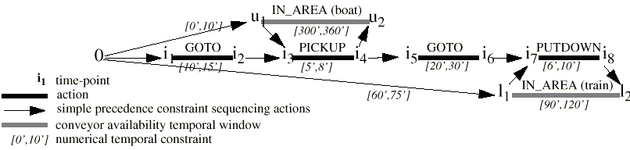
Progressive Resource Allocation
Vidal et al. “Incremental Mission Allocation to a Large Team of Robots”, 1996
Context: autonomous robots in a harbour environment
  repetitive storehouse tasks to move a container from a location to another: three basic actions

Slide 47
Uncertainty and Optimization
Temporal uncertainty
  uncertain durations [l_{i}, u_{i}] for actions
  uncertain arrival and departure times for boats and trains → uncertain time windows for pickup/putdown actions
Goal: centralized planner allocate robots to tasks while minimizing the overall makespan
  always choose the closest robot

Slide 48
Approach
Interleave execution and scheduling over a rolling time-horizon
  1. iterative allocation of robots to successive tasks: which robot is expected to arrive first?
    easy in the short-term, then temporal uncertainties sum up and make the choice less obvious: stop
  2. wait until execution gives real times that makes next choice possible: goto 1

Slide 49
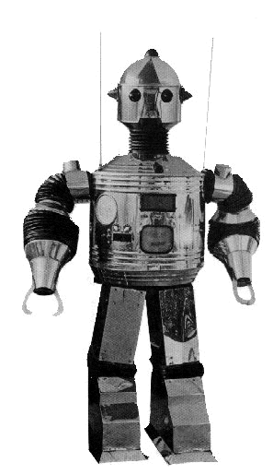
Allocate Tasks

Slide 50
Execute
now

Slide 51
Execute & Allocate
now

Slide 52
Execute
now

Slide 53
Conclusions

Slide 54
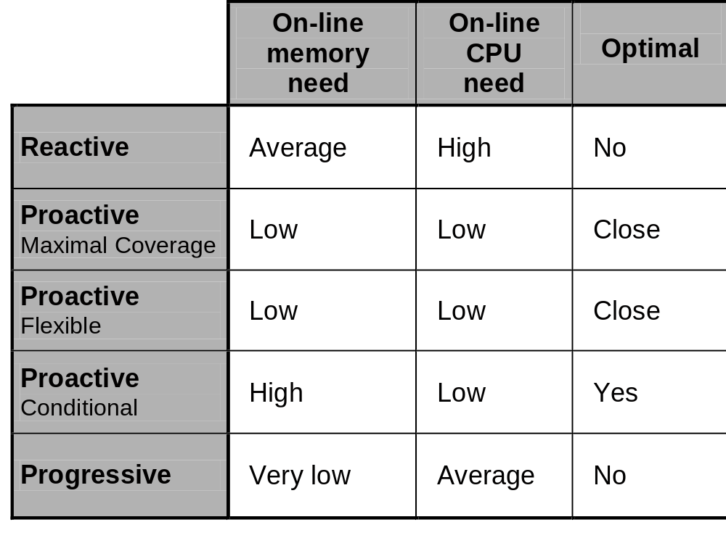
Properties of the Approaches

Slide 55
Scope of Techniques
Reactive
  → unpredicted & low probability events/outcomes
Progressive
  → predicted events but asynchronous: unknown timing/value
    e.g., arrival of new order/goal, data collection
Proactive
  → known and most probable events/outcomes
  → synchronous observations

Slide 56
Putting it All Together
Reactive techniques
  unavoidable
Progressive techniques
  limit the need to replan → more reliable plans
Proactive techniques
  limit the frequency of on-line reasoning
Reactive/Progressive techniques
  limit the sub-optimality of flexible schedules and memory blow-up of conditional schedules

